Slide 1
Conduct of parents and the impact on child; what amounts to alienating behaviours and how to approach the management of cases
Scott Sharp

Slide 2
Terminology:
Resident parent: the parent with whom the child lives, often the respondent to allegations of alienating behaviours
Non-resident parent: the parent with whom the child does not live, often the allegation maker
Parental alienation: the finding that a parent has acted in a way to cause an impact to the relationship between the child and the other parent.
Alienating behaviours: the specific allegations of conduct, used to describe the actions taken by the alienating parent.
The above terminology is set out to aid the reading of this note, and are the authors own definition, but it should be acknowledged that alienating behaviour can be demonstrated by either parent.

Slide 3
What is it?
The issue of alienation has been a long considered and complex issue, with no clear definition. However, there are multiple sources on what should be defined as alienation. I note at this very early stage that in most cases of alienation there is very little, typically indirect, or no contact at all between the child and non-resident parent.
The unjustified resistance or hostility from a child towards one parent as a result of psychological manipulation by the other parent’. This is the previous parental alienation definition from Cafcass, however as of June 2022 Cafcass guidance and use of terminology changed.
Cafcass now use the umbrella term alienating behaviours defined as; The term used to describe circumstances where there is an ongoing pattern of negative attitudes, beliefs and behaviours of one parent (or carer) that have the potential or expressed intent to undermine or obstruct the child’s relationship with the other parent.

Slide 4
Further definition available to practitioners;
Parental alienation cases.
These are disputes where the child expresses a strong and unjustified dislike of the non-resident parent. The child's feelings are often influenced by the parent with whom they live, who subconsciously or consciously alienates the child against the non-resident parent, through vilification or more subtle behaviour. This results in the child becoming alienated from the non-resident parent with whom they have no contact. Parental alienation is "a process of manipulation" perpetrated through "alienating behaviours" and is a question of fact (Re C (Parental Alienation: Instruction of Expert) [2023] EWHC 345 (Fam)).
Despite a formal shift of language by Cafcass from parental alienation to alienating behaviour, the language remains, to an extent, interchangeable. On the reading of recent case law, I therefore distinguish the terminology, as set out above, from the allegation made pending findings, and the findings found as to which language would be appropriate. However, it is also important to note that as practitioners there is a more practical shift in the use of language to only using alienating behaviours.

Slide 5
Nonetheless, it is always important to remind ourselves of the impact alienating behaviour has on the children;
Ayesha: “Being exposed to alienating behaviours feels like you’ve heard so many things from one [parent] it starts to be- come believable. Although you don’t know the truth, you’re made to feel like it’s the only truth. You’re constantly made to feel as if the other parent hates you, wants nothing to do with you. Badmouthing one another, and others getting involved agreeing [with them]. When you walk around the streets on your own, you always see that perfect family: Mum, dad and two children, and you think to yourself that it’ll never be you.”

Slide 6
What can it look like?
The behaviour in question is a parent’s own conduct amounting to a negative impact on the child against the other parent. Such behaviour can include (but not limited to) the following;
repeatedly or constantly criticising or belittling the other;
unjustifiably limiting or restricting contact or undermining contact;
forbidding discussion about the other parent;
creating the impression that the other parent dislikes or does not love the child, or has harmed them or intends them harm;
denying emotional responsiveness to the other parent or spurning, terrorising, isolating, corrupting, or exploiting them.
Authors additional views;
Negative emotional reactions of the parent to the child’s normal daily discussions, which the child may seek to mirror;
Silence
I’m sure many of us have handled cases or dealt with cases where one parent is alleging the other has acted in a way which has caused harm, to either the other parent or child, and the other completely denies that narrative

Slide 7
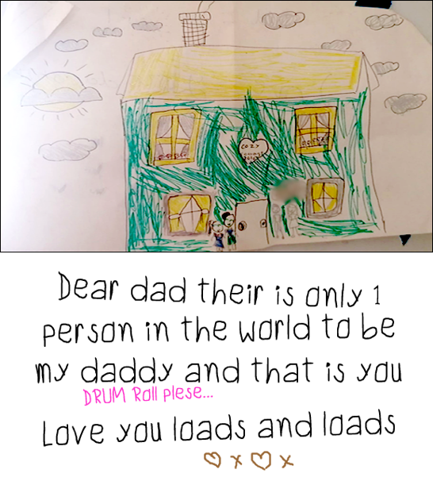
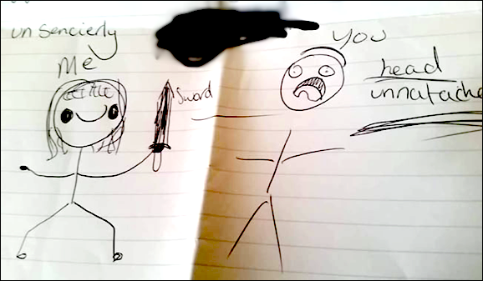
Alienating behaviours are often not a singular clear action, and may often amount to collective small steps taken by a parent over a period of time. In order to identify its existence, it would therefore be appropriate to initially consider the child and any behaviour they are displaying.
As noted above an absolute refusal for contact with a parent is the obvious demonstration of this behaviour, particularly if there was a previous loving relationship. However, there are other presentations to consider. The below images were provided by a 9-year-old child, a few months apart and after alienating behaviours were deployed by one parent*;
*I caveat the above as it has been taken from parental alienation UK website, and this is how it is presented.

Slide 8
If a child did present with the above images, it would be obvious that the dynamics within that family unit needs to be looked into. Answers as to why that behaviour is being exhibited by the child and if there is a connection to be made with the possible actions of one parent would create the framework to consider alienating behaviours.
In Re S (Parental Alienation: Cult) [2020] EWCA Civ 568, the mother was raising the child to confirm to a particular belief system. On the face of it, nothing inherently alienating. However, the same had been found to be a cult and in pursuit of this belief required the condemnation of the other parent’s way of life. Such action was found to be alienating behaviour.
The Court of Appeal emphasised that to address parental alienation in a case involving one party's adherence to the all-encompassing belief systems of a harmful cult, that party needed a genuine commitment to extricate themselves and significant therapeutic support.

Slide 9
However, day-to-day cases can often be hard to identify. The fact that a child is resistant to spending time with a parent, does not automatically mean that the child has been exposed to alienating behaviours from the other parent.
The question practitioners should consider would be; is the child’s response to actions of one parent justifiable? For example, if there are additional allegation of domestic abuse, to which the child may have witnessed - is it possible the child does not wish to see the perpetrator due to being a victim of domestic abuse.

Slide 10
How to evidence alienating behaviours:
Courts not experts must determine the question of parental alienation; Re GB (part 25 application: Parental Alienation) [2023] EWFC 150. The court should address whether expert evidence is necessary by reference to the factors in section 13(7) of the CFA 2014. A judgment providing reasons for rejecting one party's submissions or preferring the submissions of another party is fundamental to the court's duty to deal with the case justly.
Allegations must be suitably evidenced much like other allegations of abuse, and are inevitably an issue that will need a fact-finding hearing. The same will often need to be holistically approached and presented as it is likely the child’s behaviour has changed over a period of time. The burden of proof is no different to the normal standard applied in the family courts

Slide 11
Unfortunately, due to the very nature of the allegations it is likely the court will have no objective evidence before it. The balance will weigh in our client’s credibility and attitude to the Court and proceedings.
It should be further noted that within these types of cases it is readily acknowledged that it is often appropriate to make the child a party to the proceedings and appoint a children’s guardian under rule 16.4 of the Family Procedure Rules 2010. Practice Direction 16A sets out guidance on circumstances which may justify making the child a party. Included in that list at §7.2(c):
‘Where there is an intractable dispute over residence or contact, including where all contact has ceased, or where there is irrational or implacable hostility to contact or where the child may be suffering harm associated with the contact dispute’.

Slide 12
Draft Guidance
The current draft guidance states a Court would need to be satisfied that three elements are established before it could conclude that alienating behaviours had occurred:
The child is refusing, resisting, or reluctant to engage in, a relationship with a parent or carer;
The refusal, resistance or reluctance is not consequent on the actions of the non- resident parent towards the child or the resident parent; and
The resident parent has engaged in behaviours that have directly or indirectly impacted on the child, leading to the child’s refusal, resistance, or reluctance to engage in a relationship with the other parent.

Slide 13
Important highlights
- If the three elements (above) of the issues for the Court to find are set out, then the case must be allocated to the
Judge.
- The Court will be seeking to actively and robustly manage cases to avoid alienating behaviours being raised at a late
stage;
If a course of conduct is alleged narrative statements will likely be necessary at an early stage;
A guardian will often be appointed to act for the Child with proceedings where alienating behaviour has been raised.
Cost: where the child has been joined as a party to the proceedings, all parties will be expected to pay towards the costs of the same.

Slide 14
A finding of parental alienation is not an automatic element that will result in a change of residence, albeit it this is often open for consideration. An order transferring a child from the care of one parent to the care of another solely on findings of alienation, will be rare.
Additional expert are not always necessary, but if they are careful consideration to the appropriate expert and should keep in mind the interim guidance on the same, as well as that recently provided in Re C.
The draft guidance is currently in the consultation phase. The consultation will run until 4.00 pm on 16 October 2023. Responses should be sent to FJC@justice.gov.uk with the subject header, Response to FJC consultation on alienating behaviour.

Slide 15
