Slide 1
The reality of creating inaccurate documents….
Certainly not myth, and very much a reality!
Laura Buchan

Slide 2
It is becoming easier to create ‘Novelty’/ ‘Joke’ documents from a plethora of websites with a quick and simple Google search. Some of these documents are able to be created for free or at a set cost pricing.
The wide variety of ‘novelty’ documents are easily available and simply come with a user ‘warning’ on how such documents shall be utilised. Here is a non-exhaustive list of some of the documents:
Whatsapp messages
Text/imessages
Bank statements (!)
Land registry documents
Payslips
P45/P60s
Tenancy agreements
Credit score reports
Utility bills
Flight tickets
Translation services/documents

Slide 3
Another more commonly used and accessible tool is the creation of temporary emails….
🤯
Disposable email - is a free email service that allows to receive email at a temporary address that self-destructed after a certain time elapses. It is also known by names like : tempmail, 10minutemail, 10minmail, throwaway email, fake-mail , fake email generator, burner mail or trash-mail. Temp-Mail - is most advanced throwaway email service that helps you avoid spam and stay safe
https://temp-mail.org/

Slide 4
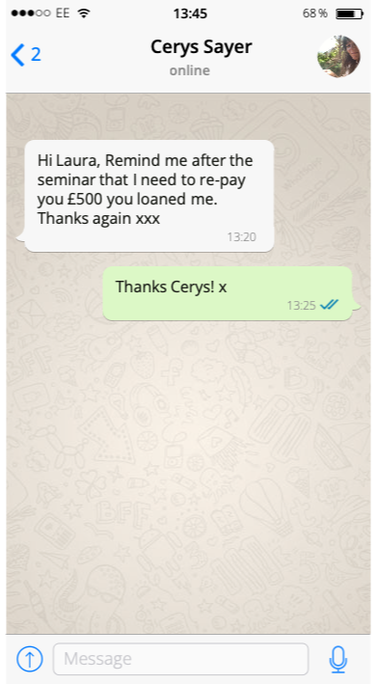
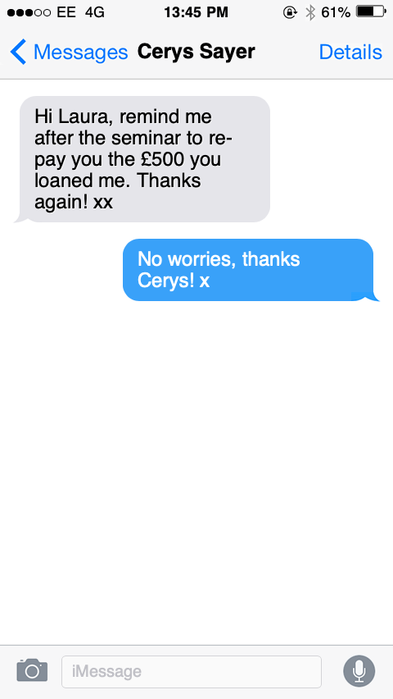

Slide 5
https://ifaketextmessage.com/
https://www.fakewhats.com/generator

Slide 6
https://www.fakebankstatement.co.uk/products.html
https://www.replaceyourdoc.com/samples.html

Slide 7
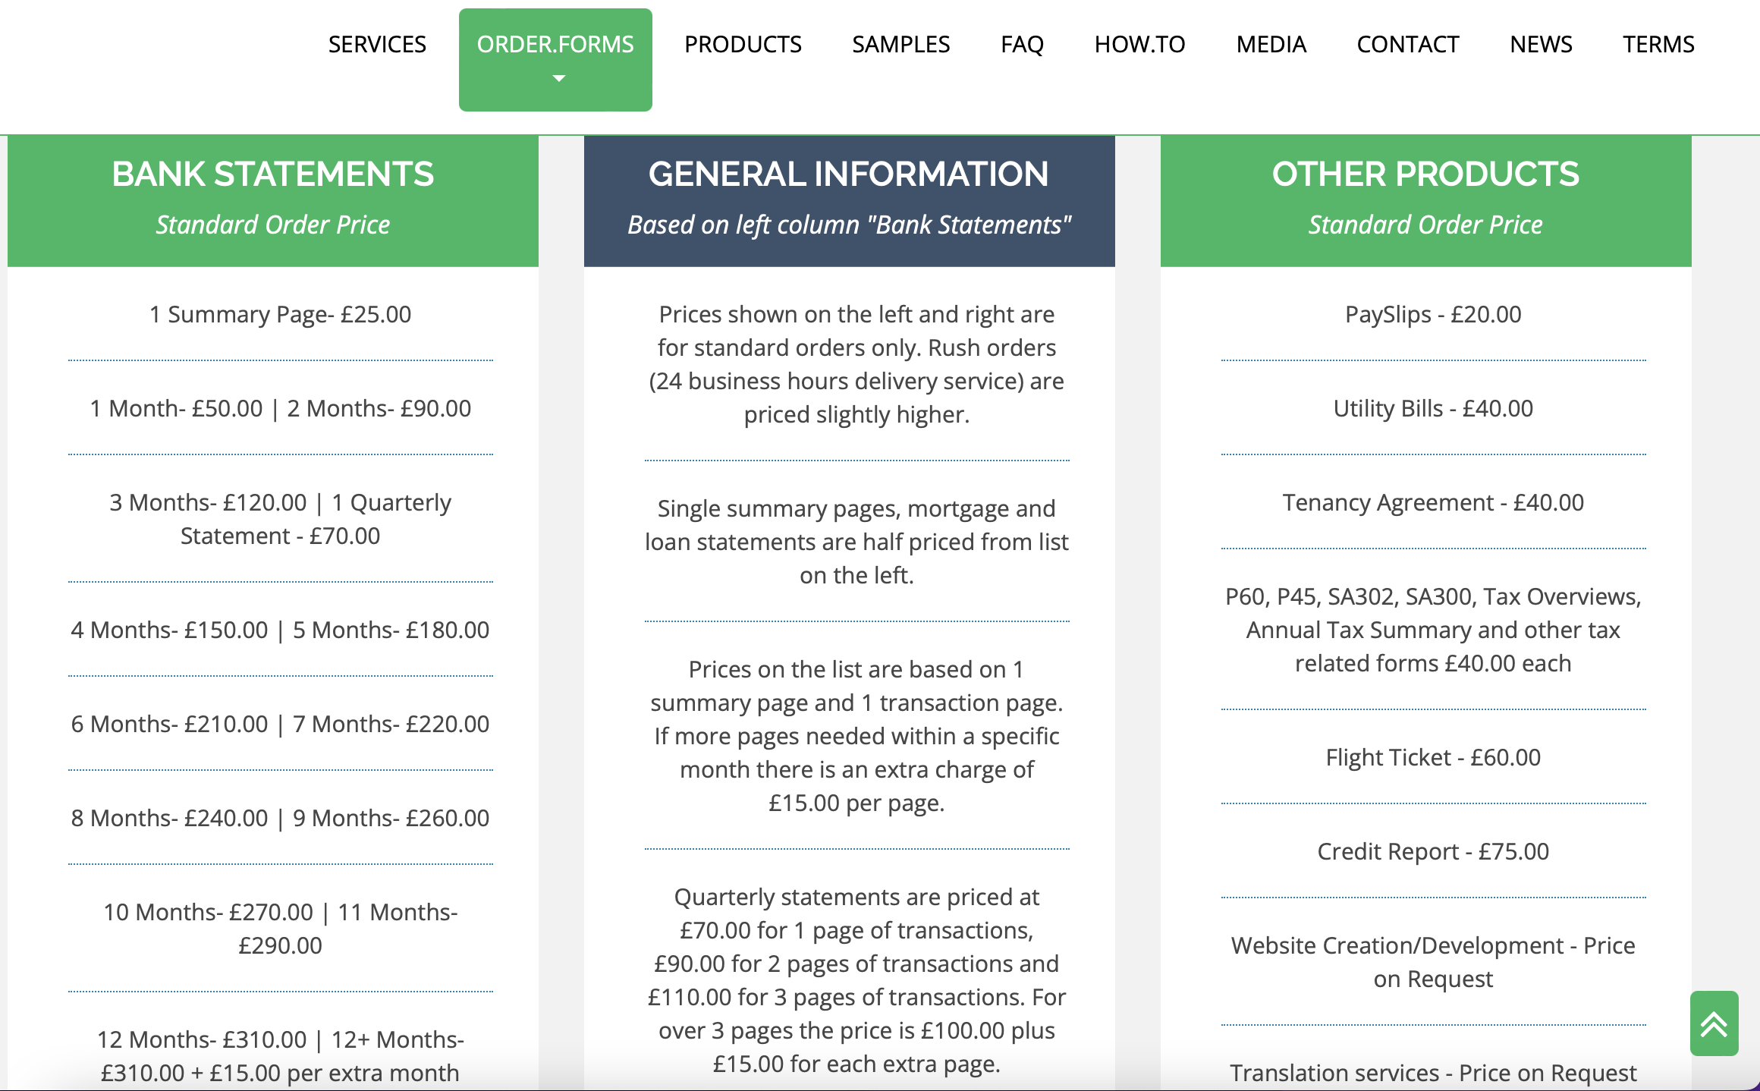

Slide 8
It would seem the FPR is behind the curve in recognising the danger of electronic documents, in comparison to the CPR (31B(6) (4)
6 When considering disclosure of Electronic Documents, the parties and their legal representatives should bear in mind the following general principles –
(1) Electronic Documents should be managed efficiently in order to minimise the cost incurred;
(2) technology should be used in order to ensure that document management activities are undertaken efficiently and effectively;
(3) disclosure should be given in a manner which gives effect to the overriding objective;
(4) Electronic Documents should generally be made available for inspection in a form which allows the party receiving the documents the same ability to access, search, review and display the documents as the party giving disclosure; and
(5) disclosure of Electronic Documents which are of no relevance to the proceedings may place an excessive burden in time and cost on the party to whom disclosure is given.

Slide 9
So what as practitioners can we do?
There are no set guidelines, but would recommend everyone read the article of Helen Brander. The core message of this seminar is that we need to be HYPERVIGILENT and not assume documents are accurate, as a default.
Top things to think about:
Third party disclosure orders
Requesting original documents to check the Meta data of creation/modification
Request phone records from telephone providers
Check Official Copy Entries in respect of Land Registry document
Check Companies House (where applicable) with accounts available
CHECK messaging evidence:
Are the bubbles the correct colour?
Are dates in UK format?
Correct provider/times of settings
Font sizes

Slide 10
Thank you for joining us. If we can be of any further assistance, please do not hesitate to contact us.
https://www.linkedin.com/in/laura-buchan-454233101/
https://www.linkedin.com/in/cerys-sayer-913b4b112/
Family@westgate-chambers.co.uk
LinkedIn | YouTube |Family Law Week Podcast

