Slide 1
Costs and Non-Court Dispute Resolution
Laura Buchan

Slide 2

Costs in a ‘whole new world’ of Non-Court Dispute Resolution….

Slide 3

Recap of the relevant changes made in April 2024
FPR 3.3(1A) has been inserted, which provides for an obligation to file and serve a form (FM5) ‘setting out their views on using non-court dispute resolution as a means of resolving the matters raised in the proceedings’.
FPR 3.4(1A) has been amended to ‘encourage parties, as it considers appropriate’ to undertake NCDR
PD9A - Financial Remedy Pre-action Protocol (later be reviewing the annex in more detail)

Slide 4
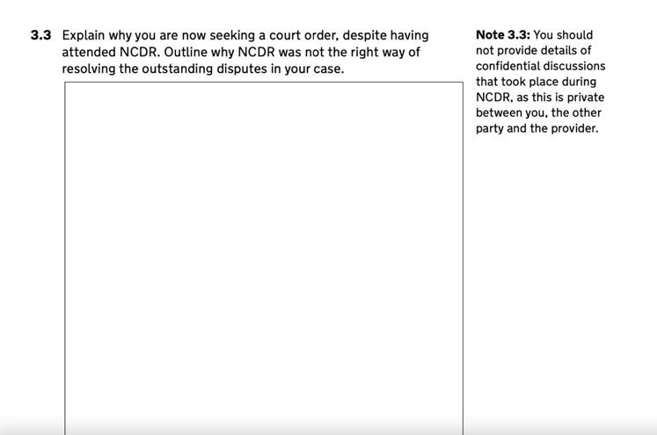
FM5
PD3A 10C requires FM5 to be filed and served 7 days (or another date set by the court) and must be signed by a statement of truth.
An FM5 can be used as evidence in support of any costs application.
The more detail the better. ‘Mediation failed’ is unlikely to be sufficient for the courts

Slide 5
What is a Judge likely to want to see as real consideration to NCDR?
It is becoming increasingly common for the courts to be scrutinising real engagement and consideration in NCDR, and any exemptions claimed. Practitioners need to begin thinking more broadly from the outset of instruction.
- If parties have entrenched views and it becomes clear early on the mediation will not progress matters… has consideration been given to voluntary financial exchange and an early neutral evaluation/Private FDR? This will allow parties at an early stage be prepared of the likely outcome at court.
Are children involved? Has consideration been given to eligibility of mediation vouchers
Eligibility of legal aid for mediation? (For both client and any a litigant in person on the other side)
Have parties attempted to utilise other types of mediation?
Collaborative process attempted?

Slide 6

What if parties do not agree about the suitability of NCDR or an exemption has been claimed?
It should be made clear at the early stages what the parties’ position is in respect of NCDR. Parties should think constructively and utilise experience to guide clients to properly engage… and advise of the possible cost consequences if they do not! For example what if:
- In the event one party represented asserts an exemption due to Domestic Abuse? (PD 3A, 20) Could NCDR to be arranged accordingly to make this safe?
- Application issued due to urgent issue which is now resolved?
-Factual issue by preliminary issue has now been determined?

Slide 7
It is crucial to document from the earliest outset the position on NCDR and reasons for this, and these practical points should be included in the FM5.
If the court considers a party has not properly (or has failed to) engage and the matter is ineffective, wasted costs will likely be at the forefront of a client’s mind, even if reserved.
This should be anticipated and the necessary N260 should be provided. Practitioners should be prepared to make and oppose costs applications.
Failure to attend continues to be under review - PD3A 10E ‘If the court allows time for parties to attend non-court dispute resolution, or adjourns the proceedings specifically for that purpose, any failure of a party, or parties, to then attend non-court dispute resolution will not affect any substantive decision the court makes in the proceedings. However, the court may take the parties’ conduct in relation to attending non-court dispute resolution into account when considering whether to make an order for costs in relation to the proceedings: see Part 28 FPR’

Slide 8

Annex PD9A Financial Remedy pre-action protocol
https://www.justice.gov.uk/courts/procedure-rules/family/practice_directions/pd_part_09a#IDADD5S
2. Before coming to court, unless there are safety concerns or other good reasons not to do so, the court will expect parties to have attended at least one form of NCDR. Please see paragraphs 10, 11, and 12 of the Protocol for more details
5. If the parties have not attended a form of NCDR, the court may decline to commence the court timetable or suspend the court timetable so that the parties may attend a form of NCDR. The court will also take into account any failure by a party to attend a form of NCDR when considering the question of costs (together with any other failure to comply with the Protocol, see paragraph 25) and may make an order requiring that party to pay the other party’s costs.
6. To comply with this Protocol the court will usually expect the parties to have done the following:
a. attended a MIAM with an authorised mediator, unless a valid exemption applies;
b. considered, and unless there is good reason for not doing, proposed and engaged in appropriate non-court dispute resolution;
c. provided full disclosure (information relevant to the issues in dispute) to the other party, including appropriate financial disclosure;
d. clearly set out their position (including the orders they would wish the court to make were proceedings started); and
e. attempted negotiation (trying to agree the issues in dispute) by making reasonable proposals for settlement.
7. Before starting court proceedings, the parties should attempt, where possible, voluntary financial disclosure and negotiation. Any disclosure must be full, honest and open. Parties must be advised of this duty by their legal advisers, including the ongoing duty to disclose any material changes. Requests for disclosure must be necessary, relevant and limited to what is reasonably required.

Slide 9
10. Non-court dispute resolution is defined in rule 2.3
11. The court may also consider the parties having obtained legal advice via the “single lawyer” or a “one couple, one lawyer” scheme as good evidence of a constructive attempt to obtain advice and avoid unnecessary proceedings, if they have complied with paragraph 6 above.
12. Although there is a place for constructive negotiation via correspondence between legal representatives, that alone shall not be a sufficient attempt at non-court dispute resolution for the purposes of this Protocol. Other forms of negotiation between legal representatives, such as round-table meetings, may be considered sufficient depending on when and how they took place
REMEMBER - This Protocol applies to all applications for a financial remedy as defined by rule 2.3. It covers all classes of case, including applications for periodical payments, lump sum, property adjustment and/or pension sharing orders. It applies whatever the size of the parties’ assets and whether it is a so-called “needs” or “sharing” case. It applies whether the parties are legally represented or not.

Slide 10
17(v). by rule 28.3(7), a failure, without good reason, to attend non-court dispute resolution is an express reason for the court to consider departing from the general rule of no order as to costs.
21. Parties and legal representatives must always bear in mind the court’s overriding objective as set out at rule 1.1 to resolve cases justly, as quickly and fairly as possible, in ways that are proportionate to the nature, importance and complexity of the issues, and without costs being unreasonably incurred. By rule 1.3 the parties are required to help the court further the overriding objective. These obligations apply equally to conduct before as well as after proceedings have started
25. Parties and legal representatives should be aware that where a court is considering whether to make an order requiring one party to pay the costs of another party, it will take into account (i) any open pre-application offers to settle; (ii) if a party did not attend a MIAM and was not exempt from doing so; (iii) the FM5; (iv) whether a party has provided appropriate financial disclosure and, if so, when; and (v) a failure, without good reason, to attend non-court dispute resolution or a premature and unjustified abandonment of ongoing non-court dispute resolution.

Slide 11

CASE LAW

Slide 12
NA v LA [2024] EWFC 113, whereby Recorder Allen KC stayed the proceedings of his own initiative (as per FPR 3.4 (6)), following interim issues being dealt with. Within this case, W was opposed to this and sought court directed disclosure, claiming little knowledge of H’s financial position. This was rejected by Recorder Allen KC and the decision confirmed that there is no need for financial disclosure before parties engage in NCDR and the disclosure will almost always be provided as part of the NCDR process in any event.

Slide 13
In HJB v WJB (financial remedies) (separation agreement - application to show cause) [2024] EWFC 187 per Her Honour Judge Vincent, having determined as a preliminary issue that a separation agreement reached between the parties stood, said:
[125] “The parties will need some time to reflect on the decision and consider directions. In accordance with the changes to the Family Procedure Rules Part 3, Practice Direction 3A and Part 28 of the Family Procedure Rules, the Court will be seeking to focus the parties' minds on the potential for non-court dispute resolution of remaining issues between them as a next step and before further costs are expended in this litigation.”

Slide 14
Whilst the starting point in financial remedy proceedings has been no order for costs, the court may now consider a party's failure to engage in NCDR or a MIAM as a matter of conduct when determining costs orders (FPR 28.3(7)(aa) and paragraph 10E, PD 3A). Costs orders being made whereby parties have failed to engage in NCDR following the court’s encouragement can be seen in case law. (WL v HL (rev 1) [2021] EWFC B10 and JB v DB [2020] EWHC 2301)

Slide 15
Within Civil proceedings following Churchill v Merthyr Tydfil County Borough Council [2023] EWCA Civ 1416, the Court of Appeal held that the court has the power to stay proceedings and make an order compelling parties to participate in any suitable form of NCDR process at whichever stage of the proceedings it considers appropriate provided to do so would be compliant with Article 6 rights to a fair trial. The changes in the CPR came into effect from 1st October 2024.
While this is not currently the position in family proceedings, as set out above, the remarks of Knowles J in X v Y (Financial Remedy: Non-Court Dispute Resolution) [2024] EWHC 538 (Fam), in which the court stated that it would be “unwise” to assume the decision in Churchill v Merthyr Tydfil was irrelevant to family proceedings and:
[15] “In financial remedy cases, the power to encourage even unwilling parties will be reinforced by an amended rule 28.3(7) which will make the failure, without good reason, to engage in non-court dispute resolution a reason to consider departing from the general starting point that there should be no order as to costs.”

Slide 16

Will the courts begin to make punitive costs orders more regularly for failure to comply?
Will the FPR follow suit with the CPR wording as to compel NCDR?

Slide 17
Thank you for listening
Laura Buchan

