Slide 1
Capacity to litigate in financial remedy proceedings
Scott Sharp

Slide 2


Slide 3
Mental Capacity Act 2005
§2: People who lack capacity
(1)For the purposes of this Act, a person lacks capacity in relation to a matter if at the material time he is unable to make a decision for himself in relation to the matter because of an impairment of, or a disturbance in the functioning of, the mind or brain.
(2)It does not matter whether the impairment or disturbance is permanent or temporary.
(3)A lack of capacity cannot be established merely by reference to—
(a) a person's age or appearance, or
(b) a condition of his, or an aspect of his behaviour, which might lead others to make
unjustified assumptions about his capacity.
(4) In proceedings under this Act or any other enactment, any question whether a person
lacks capacity within the meaning of this Act must be decided on the balance of probabilities.

Slide 4
Just indecisive or cannot understand?
§ 3: Inability to make decisions
(1)For the purposes of section 2, a person is unable to make a decision for himself if he is unable—
(a)to understand the information relevant to the decision,
(b)to retain that information,
(c)to use or weigh that information as part of the process of making the decision, or
(d)to communicate his decision (whether by talking, using sign language or any other means).
(2)A person is not to be regarded as unable to understand the information relevant to a decision if he is able to understand an explanation of it given to him in a way that is appropriate to his circumstances (using simple language, visual aids or any other means).
(3)The fact that a person is able to retain the information relevant to a decision for a short period only does not prevent him from being regarded as able to make the decision.
(4)The information relevant to a decision includes information about the reasonably foreseeable consequences of—
(a)deciding one way or another, or
(b)failing to make the decision.

Slide 5
Litigation Capacity:
Masterman-Lister v Brutton & Co [2002] EWCA Civ 1889, [2003] 1 WLR 1511
At paragraph 75 Chadwick LJ held:
“…the test to be applied….is whether the party to legal proceedings is capable of understanding, with the assistance of such proper explanation from legal advisors and experts in other disciplines as the case may require, the issues on which his consent or decision is likely to be necessary in the course of those proceedings. If he has capacity to understand that which he needs to understand in order to pursue or defend a claim, I can see no reason why the law whether substantive or procedure should require the imposition of a … litigation friend.”

Slide 6

DPSC in Dunhill v Burgin [2014] UKSC 18, [2014] 1 WLR 933
Baroness Hale at paragraph 17 stated:
“Equally, of course, those words [of Chadwick LJ at [75]] could be read in the opposite sense, to refer to the advice which the case required rather than the advice which the case in fact received. In truth, such judicial statements, made in the context of a different issue from that with which we are concerned, are of little assistance. But they serve to reinforce the point that, on the defendant’s argument, the claimant’s capacity would depend on whether she had received good advice, bad advice or no advice at all. If she had received good advice or if she had received no advice at all but brought her claim as a litigant in person, then she would lack the capacity to make the decisions which her claim required of her. But if, as in this case, she received bad advice, she possessed the capacity to make the decisions required of her as a result of that bad advice. This cannot be right.”

Slide 7
Richardson-Ruhan v Ruhan [2021] EWFC 6
The litigation test update following Masterman :
Recent case law makes it clearer the question is not about the quality or lack of legal representations but if the party is capable of understanding with the assistance of proper explanation from legal advisers then the party would have the requisite capacity. This is, in part, to avoid a circular reading whereby a lack of representation would generate incapacity.
Munby LJ in Sheffield City Council v E & S [2004] EWHC 2808 (Fam), discusses a person may have capacity to litigate a simple case whilst lacking the capacity to litigate or engage in complex and higher risk litigation

Slide 8

Can stress result in lacking Litigation capacity?
Forresters Ketley v Brent [2012] EWCA Civ 324
‘In cases where the applicant complains of stress-related illness, an adjournment is unlikely to serve any useful purpose because the stress will simply recur on an adjourned hearing’ [25]
Richardson-Ruhan v Ruhan and others [2021] EWFC 6

Slide 9
Experts
If you have concerns for your client’s capacity you will need evidence – psychological/ psychiatric
However, it may not need to be a Court appointed and instructed expert, case and client dependent;
However, a good starting position to consider is;
the evidence should identify the medical attendant and give details of his familiarity with the party’s medical condition (detailing all recent consultations);
the evidence should identify with particularity what the patient’s medical condition is and the features of that condition which (in the medical attendant’s opinion) prevent participation in the trial process;
the evidence should provide a reasoned prognosis; and should give the court some confidence that what is being expressed is an independent opinion after a proper examination.
Levy v Ellis-Carr & Ors [2012] EWHC 63 (Ch) – when managing an adjournment

Slide 10

Is it just me or does this not make sense?
Core questions to ask yourselves;
Is the person unable to make a decision? If yes:
Is there an impairment or disturbance in the functioning of the person’s mind or brain? If yes;
Is the person’s inability to make the decision because of the identified impairment or disturbance?
Court of protection practice 2020

Slide 11
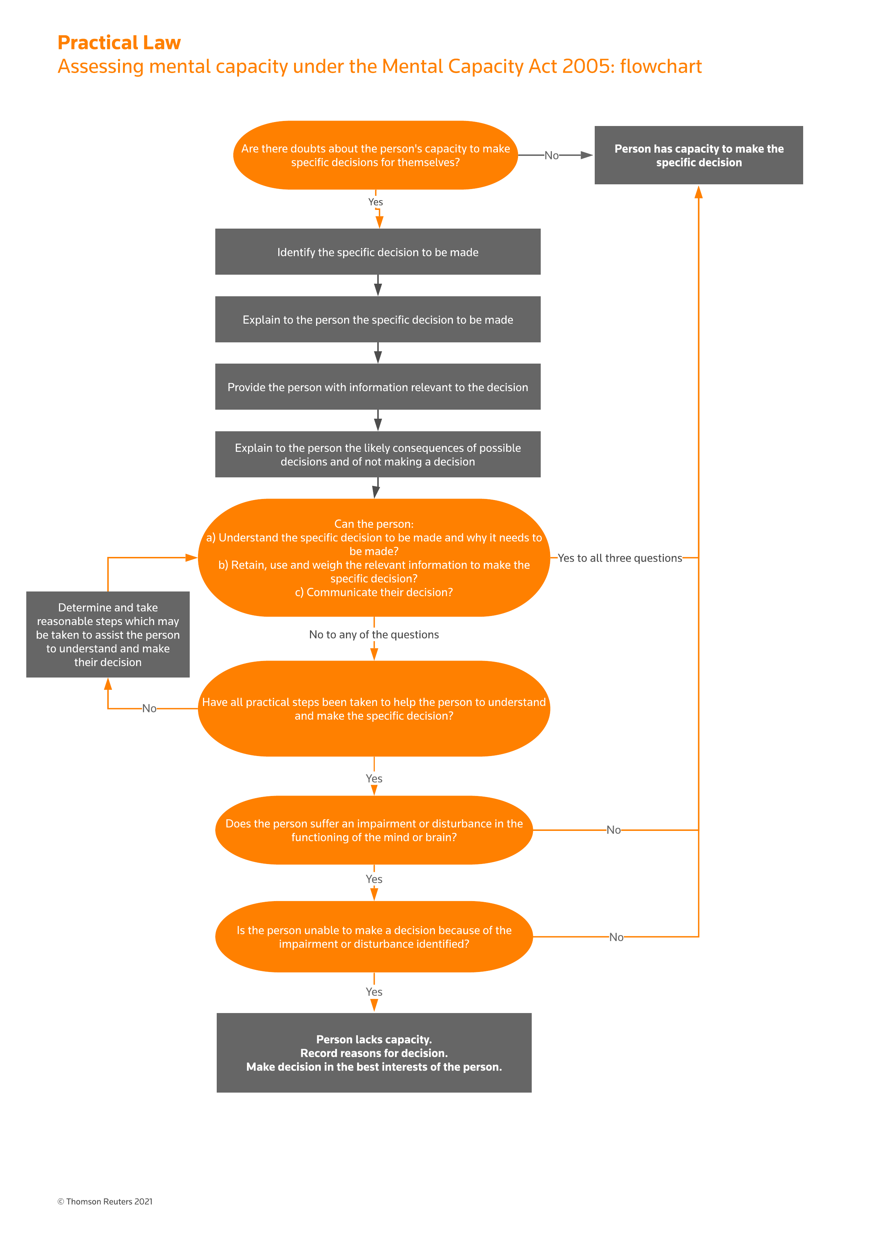

Slide 12

Litigation friends
Requirement for litigation friend in proceedings
15.2
A protected party must have a litigation friend to conduct proceedings on that party’s behalf.
Stage of proceedings at which a litigation friend becomes necessary
15.3
(1) person may not without the permission of the court take any step in proceedings except –
(a) filing an application form; or
(b) applying for the appointment of a litigation friend under rule 15.6,
until the protected party has a litigation friend.
(2) If during proceedings a party lacks capacity (within the meaning of the 2005 Act) to continue to conduct proceedings, no party may take any step in proceedings without the permission of the court until the protected party has a litigation friend.
(3) Any step taken before a protected party has a litigation friend has no effect unless the court orders otherwise.

Slide 13
You’ve got a friend in me*
*Subject to rules and guidance set by the Courts
Another adult
Competently and fairly conduct litigation
No adverse interest to that of the protected party
Hinduja v Hinduja & Ors [2020] EWHC 1533
Must undertake to pay costs which may be ordered of the protected party (subject to rights to use own protected parties funds/ be repaid)
The Court can order the change of a litigation friend and prevent a person being a litigation friend
Can be a litigation friend with or without an order of the Court
FPR 15.4 -15.8
FPR PD 15A 3.1
!!!Official solicitor as a last resort !!!!

Slide 14
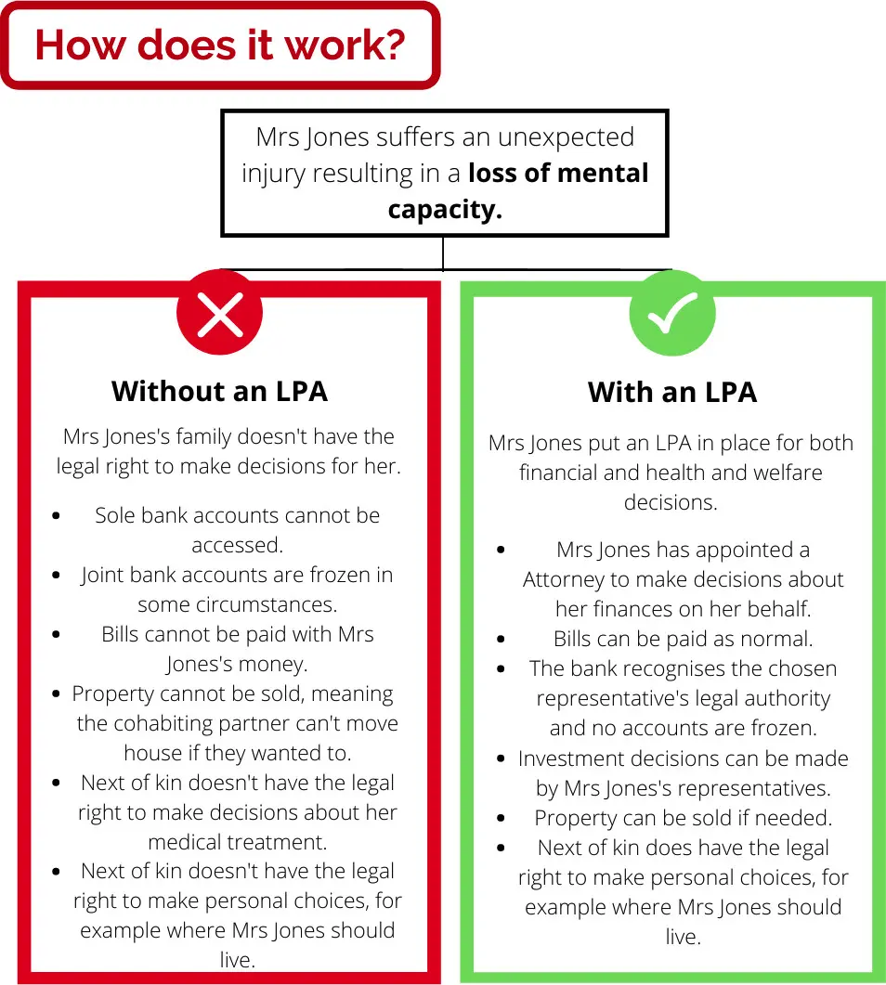
Lasting Powers of Attorney
Two Types:
Health and Welfare
Property and Financial
Important distinction when dealing with FR proceedings as you can have one or both.
Power can exist alongside the protected parties capacity or only exist when the protected party has lost mental capacity
If these exist, get a copy of the documents and check them carefully.

Slide 15
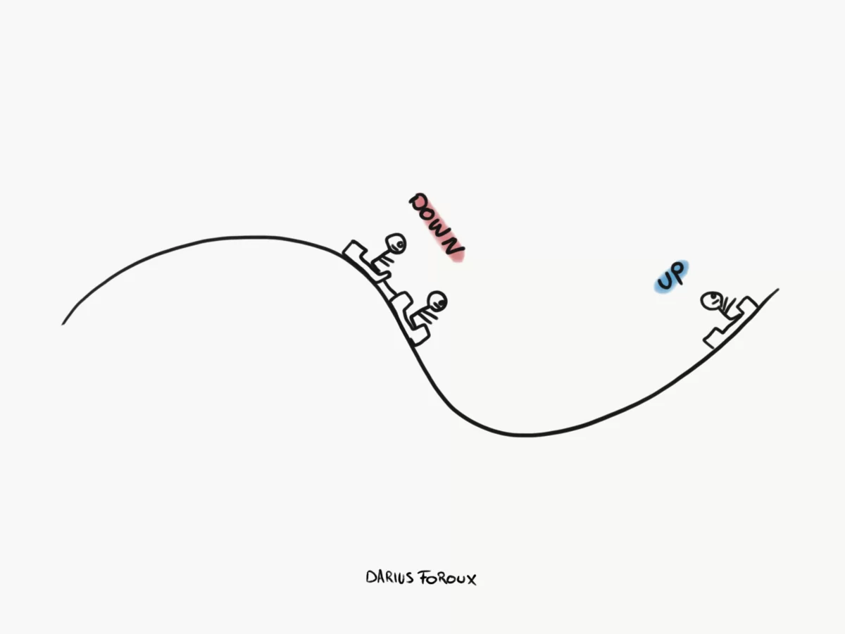
Fluctuations in Capacity
An individual’s capacity can change, and it can come and go throughout the course of proceedings;
It is a litigations friends duty to remain astute to this and inform the Court if they consider the individual has regains litigation capacity
However, a litigation friends role is only brought to an end by a Court order
FPR PD 15B 4.1 & 4.2
FPR 15.9

Slide 16

Evidence and settling – FDR considerations
Practitioners, on both sides, will need to think of the pro’s and con’s of any evidence or lack of from the protected party.
Consideration for the need and scope of the protected party to give evidence will be a case management decision.
Balance lies with Expert Evidence, if there is a treating clinician they may be most appropriate to assist
FPR PD 15B 1.4
A client lacking capacity to litigate is not an isolated reason to settle early, and the Court will still have to approve any settlement on it’s merits.
REMEMBER: litigations friends can give evidence

Slide 17

QUESTIONS?

