Slide 1
Form E: friend or foe?
Lauren Winser

Slide 2
Form E: friend or foe?
Pet peeves
Areas for improvement
Missing assets
Further guidance

Slide 3
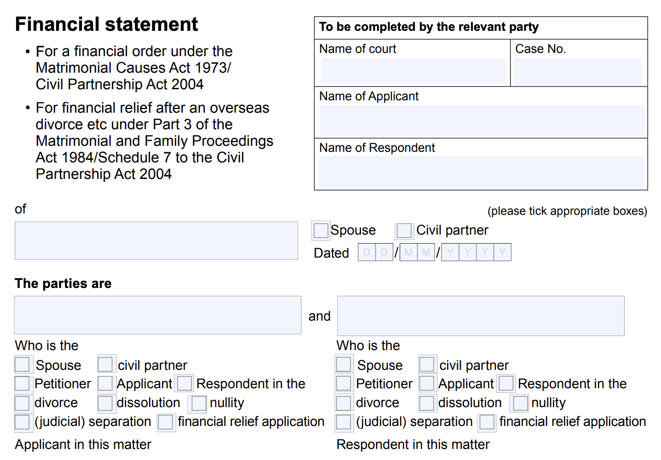
Basic information

Slide 4
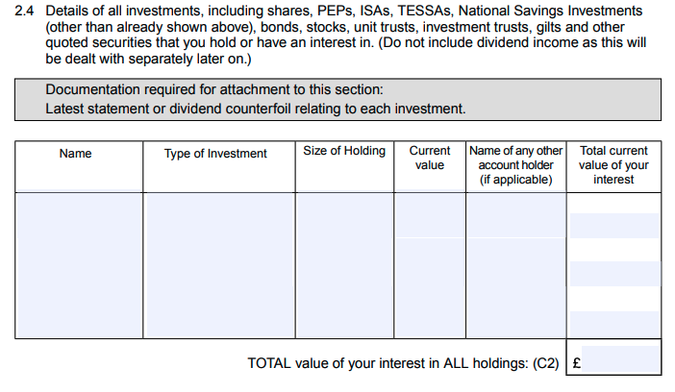
Shares
Vesting period
Reflect the true value of the shares
Reflect when that value can be released
Ownership ≠ asset

Slide 5
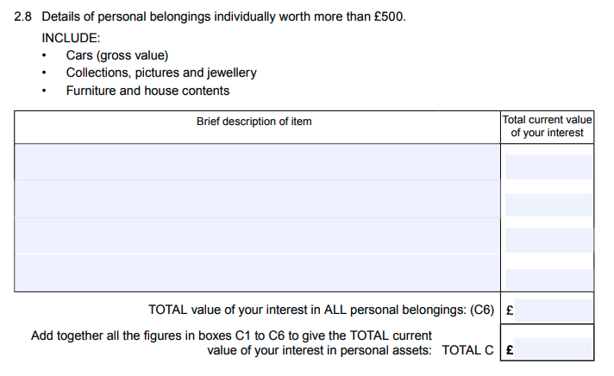
Gold
Quantity or value?
Does CGT apply?
Commentary needed
Coin collections

Slide 6
Crypto
No standalone section
Quantification
Consider crypto assets and crypto currency
NFT – non-fungible tokens

Slide 7
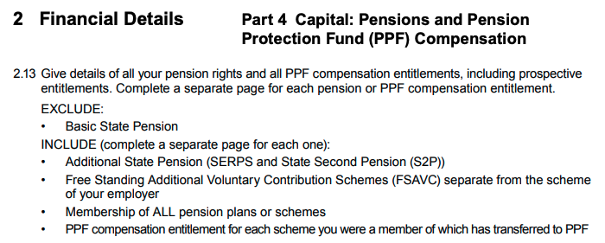
Pensions
Multiple pension assets?

Slide 8
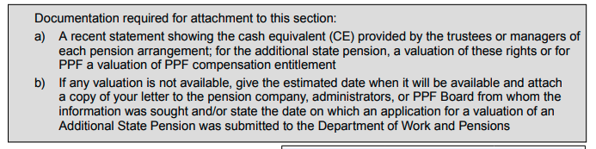
CETV – avoid “tbc”
Clearer guidance required
Informing the need for a PODE

Slide 9
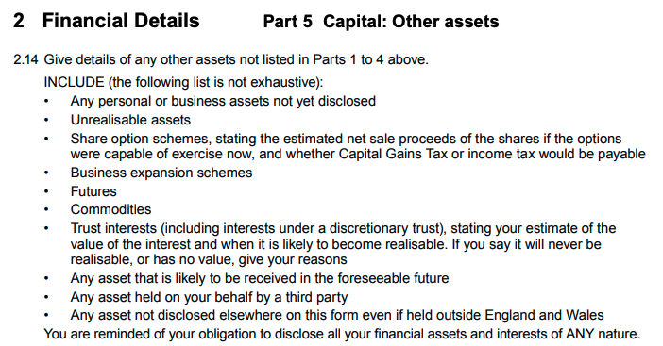
Anything else?

Slide 10
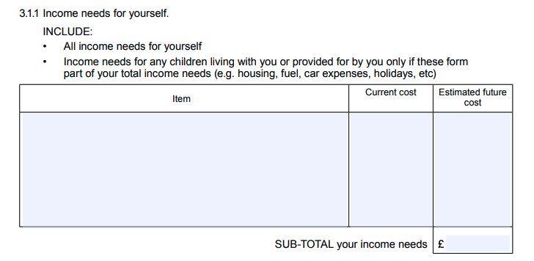
Income needs
Sample schedule
Weekly, monthly, yearly
Clearer guidance

Slide 11
Narrative sections
Too many?
Too wide?
Smear campaign

Slide 12
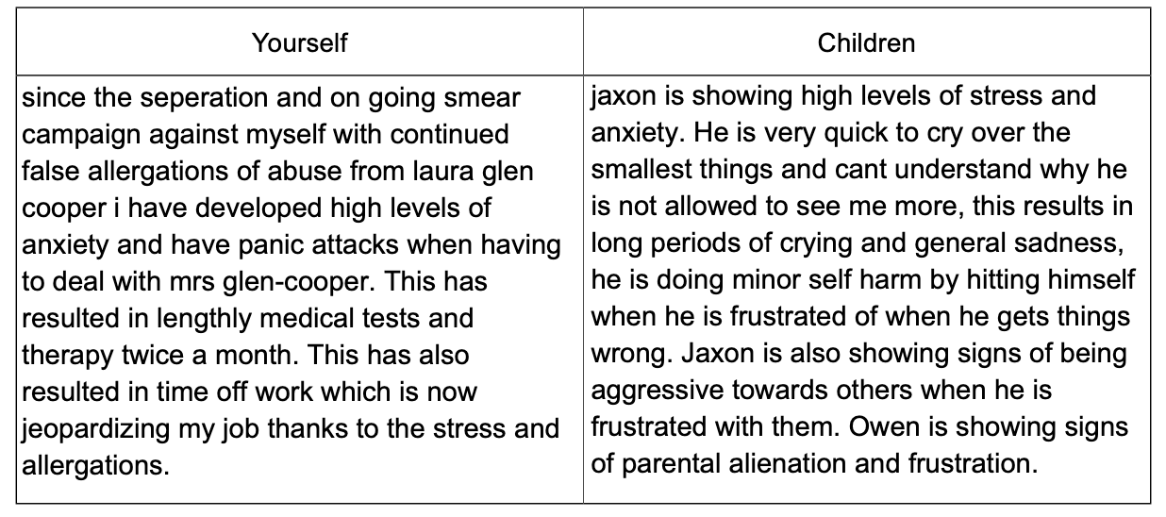

Slide 13
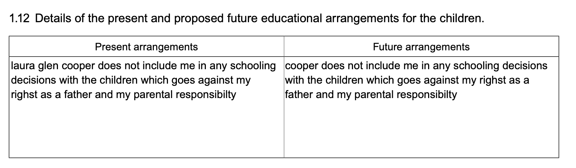

Slide 14
Reform – what could a new Form E look like?
Software-based form
Interactive
Add and remove pages as required
Links to supporting documents
Concise, focused, address the issues

