Slide 1
TOLATA TASTER
What Family Lawyers need to know!
Elissa Da Costa-Waldman

Slide 2
Why do TOLATA cases scare Family Lawyers?
NOT Family law but Civil so CPR not FPR
Easy to get caught out on the procedure
Law is a ‘witch’s brew’
Outcomes are unpredictable
Clients’ expectations – they think it’s the same as matrimonial
Where do I start?
.
Elissa Da Costa-Waldman

Slide 3
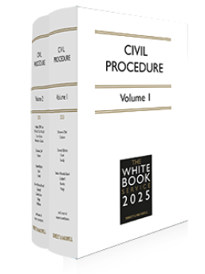
Get to know the CPR
Or find someone who does!
Rules are not difficult when you know them
Quite familiar since FPR based on CPR
Less likely to be caught out if you’re aware of the procedure

Slide 4
It is not surprising that some family lawyers find TOLATA claims daunting – this is what a LJ of appeal has said of such claims in Stack v Dowden before it reached the House of Lords-
To the detached observer, the result may seem like a witch’s brew, into which various esoteric ingredients have been stirred over the years, and in which different ideas bubble to the surface at different times. They include implied trust, constructive trust, resulting trust, presumption of advancement, proprietary estoppel, unjust enrichment, and so on. These ideas are likely to mean nothing to laymen, and often little more to the lawyers who use them.
Stack v Dowden (CA) [2006] 1 FLR 254 para 75
per Lord Justice Carnwath (as he then was)
Procedurally we don’t like TOLATA because we’re unfamiliar with the Rules
Case law is a Witch’s Brew and therefore confusing – what do we tell clients?
And the clients think they have rights and entitlements as if it were a matrimonial case!

Slide 5
Managing Client Expectations
I have rights – I’m a common law wife
We cohabited for more than 2 years (length of cohabitation relevant in Inheritance Act Claim)
Clients will need to understand that if there is a TR1 setting out the parties’ beneficial interests, that is a conclusive document of title and nothing else matters
Financial contributions irrelevant – TR1 is conclusive unless fraud or mistake
“Welfare” contribution – irrelevant unless out of the ordinary and detrimental
Existence of Children of relationship irrelevant (subject to the provisions of Section 15 TOLATA and Schedule 1 of the Children Act 1989) and only a factor for TOLATA judge in deciding whether to postpone a sale (see TOLATA s15) if minor lives in disputed property – likely sale postponement no more than 12 months

Slide 6
First Client Interview – obtain as much information as possible-
Chronology of cohabs relationship (many examples of the con man on the singles cruise looking for a rich widow!)
May not even be cohabs – parents and adult children in Right to Buy Cases
Chronology of detail of purchase of disputed property
Is there a mortgage
Did parties have a joint bank account?
Why
What purpose
Contributions to that?
Were parties engaged?
What to do next if you think your client has a potentially meritorious claim
EVIDENCE EVIDENCE EVIDENCE EVIDENCE!
Don’t waste time - obtain a copy of relevant documents ASAP

Slide 7
What sort of case am I dealing with?
Joint Ownership or Sole Ownership Case?
Obtain the conveyancing file – maybe difficult, passage of time, destroyed
Obtain the Office Copy Entries – don’t tell you everything – check out restrictions
Obtain the TR1 or JO - essential
All of these contain potentially very useful information in formulating your case and advising your client

Slide 8
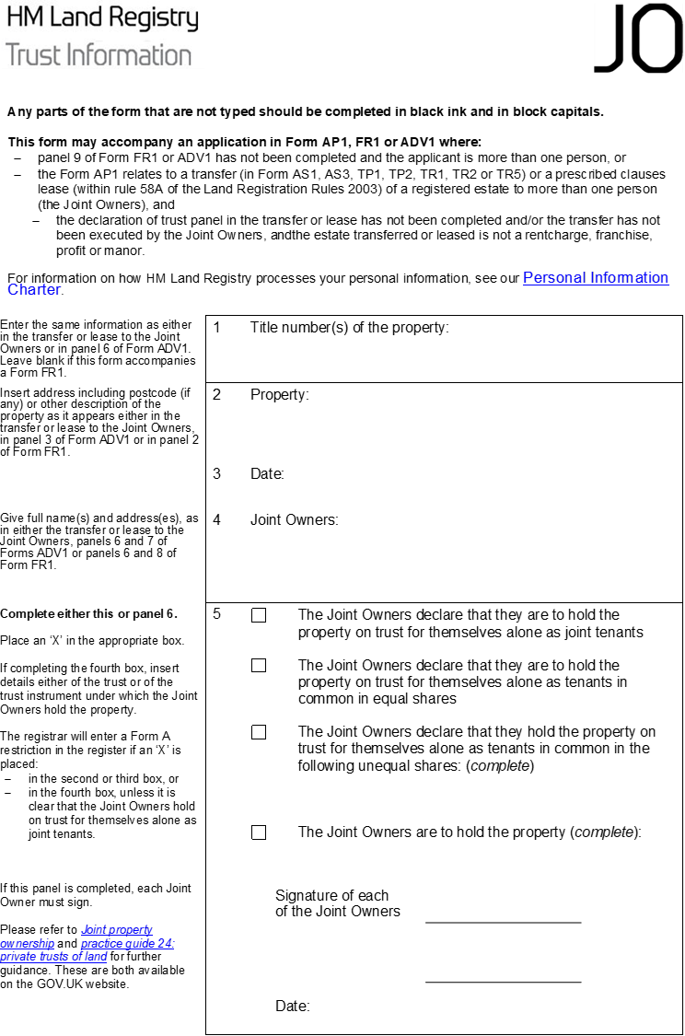

Slide 9
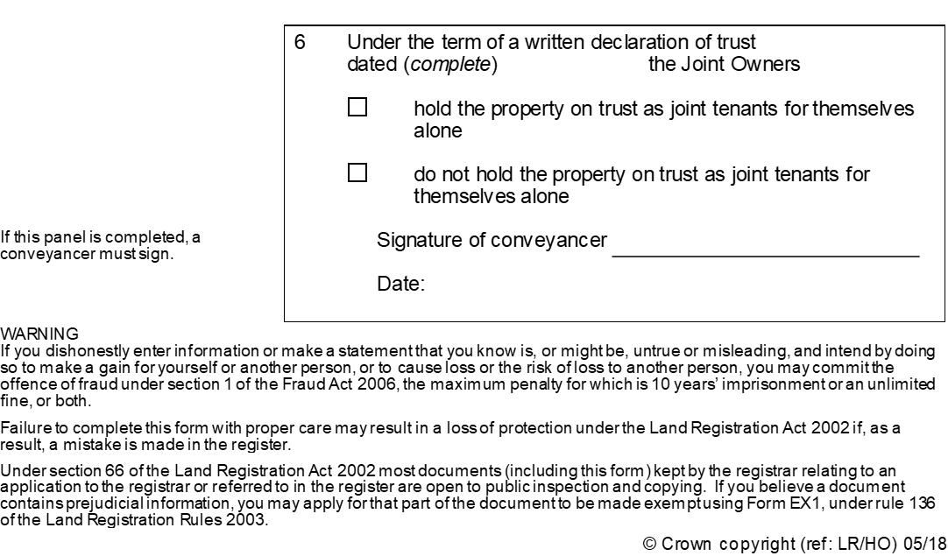

Slide 10
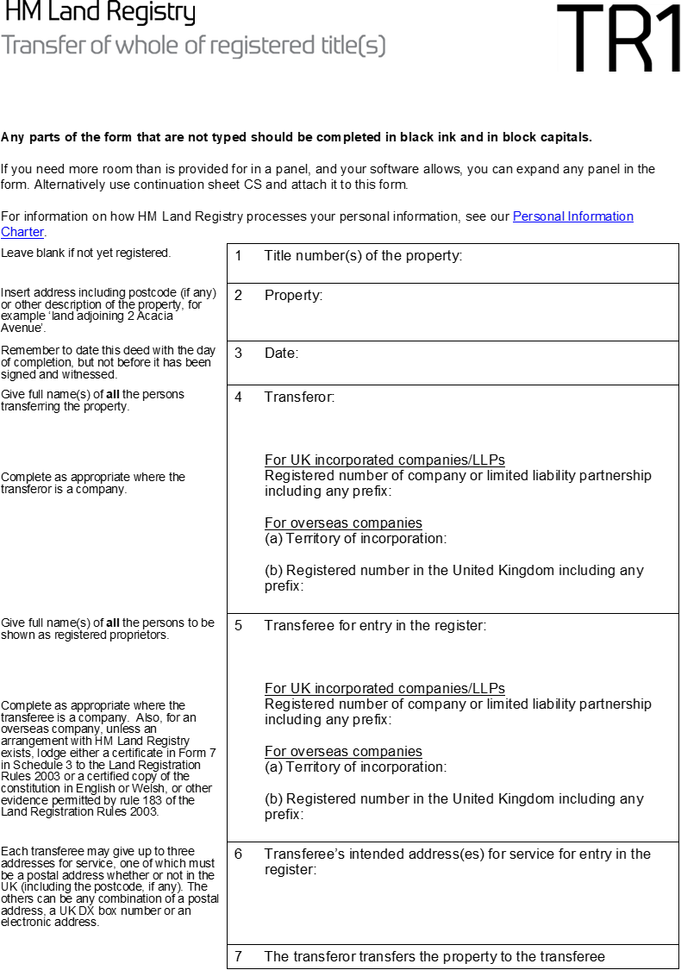

Slide 11
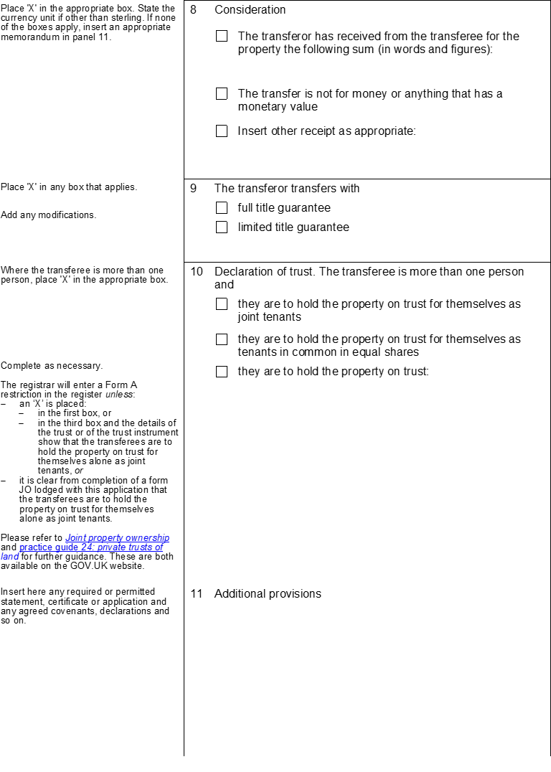

Slide 12
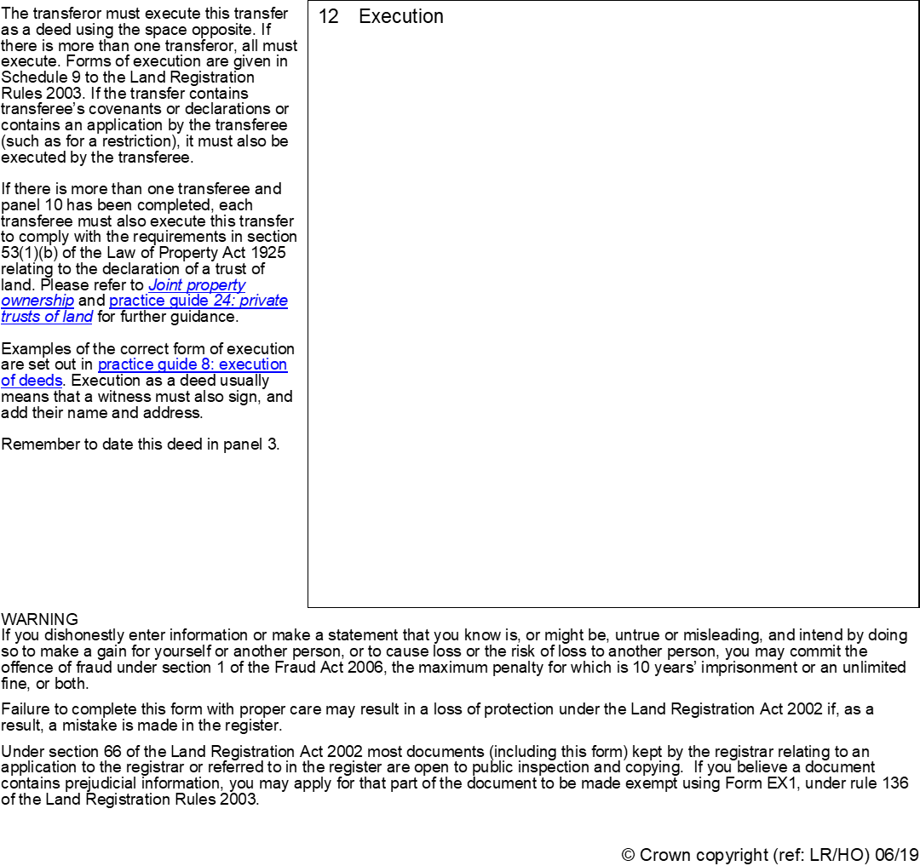

Slide 13
Goodman –v- Gallant [1986] 1 FLR 513 at p.517–
‘There was a real and important distinction between a conveyance into joint names which contained a declaration of trust of the beneficial interests and a conveyance which contained no such declaration. Where, as in this case, the conveyance contained an express declaration of trust which comprehensively declared the beneficial interests in the property, there was no room for the application of the doctrine of resulting, implied or constructive trusts unless and until the conveyance was set aside or rectified; until that event the declaration contained in the document spoke for itself.’
Pankhania –v- Chandegra [2012] EWCA Civ 1438
Judgment of Mummery LJ
26. The position is similar here, except that the express declaration of trust was for the parties as tenants in common in equal shares and not as beneficial joint tenants. There is no room for inserting a constructive trust in substitution for the express trust. Neither fraud nor mistake are alleged. No claim has been made at any stage for rectification of the transfer
27. In the absence of a vitiating factor, such as fraud or mistake, as a ground for setting aside the express trust or as a ground for rectification of it, the court must give legal effect to the express trust declared in the transfer. In the absence of such claims the court cannot go behind that trust

Slide 14
And just in case there is any doubt……………..
28. Finally, reliance on Stack v. Dowden and Jones v. Kernott for inferring or imputing a different trust in this and other similar cases which have recently been before this court is misplaced where there is an express declaration of trust of the beneficial title and no valid legal grounds for going behind it.

Slide 15
Sole Ownership Cases
Much more difficult because disputed property is already in the name of the prospective defendant party
As the court said in Jones v Kernott-
The starting point is different with sole ownership cases
First issue is whether it was intended that the other party have any beneficial interest in the property at all
If so, the second issue is what that interest is.
If the evidence shows a common intention to share but not what shares were intended, court will look at
the whole course of dealing between the parties
Each case turns on its own facts; and
Many factors to consider beyond financial contributions to assist the court in deciding what shares were fair

Slide 16
In sole ownership cases when acting for the claimant, register a restriction
Needs to be a restriction and not a notice as an interest under a trust of land cannot be protected by a notice s.33(a)(1) Land Registration Act 2002
Consult appropriate practice guide-
Land Registry Practice Guide 37 – Objections and Disputes – A Guide to Land Registry Practice and Procedures

Slide 17
Famous passage from Lloyds Bank –v- Rosset [1991] 1 AC 107
Whether there was any agreement, arrangement or understanding between the parties that the property was to be shared beneficially The finding of an agreement or arrangement can only be based upon evidence of express discussions between the partners, however imprecise the terms If such an agreement is established, the party claiming an interest must show that he/she acted to his/her detriment or significantly altered their position in reliance upon the agreement

Slide 18
How does all this information and evidence translate into legal principles/concepts?
Common intention constructive trust – requires a common intention AND detriment
Resulting Trust – get out proportionally to what contributed – paying money but no common intention
Proprietary estoppel – act to detriment based on promises/assurances made by other partner who then reneges on the promise/assurance

Slide 19
Had the client interview
Obtained documents
Established what sort of case it is
Understand the legal basis for a claim
What happens next?

Slide 20
Pre-action conduct – the court will expect parties to have sufficient information to-
Understand each other’s position
Make decisions about how to proceed
Try to settle the issues without proceedings
Consider a form of NCDR to assist with settlement
Support the efficient management of the proceedings and
Reduce the costs of resolving the dispute
This is done by way of a properly drafted Letter Before Claim

Slide 21
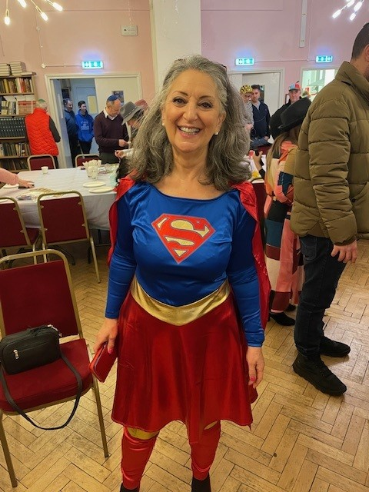
And finally – if you need some help with a TOLATA
Case…………………

Slide 22
Elissa Da Costa-Waldman

